Slide 1
Adrian Turner
On our first date i would take her out to eat to a restaurant of her choice.
I would

Slide 2
Adrian Turner

Slide 3
Adrian Turner’s Tobacco history
1492- Columbus discovered term Tobacco

Slide 4
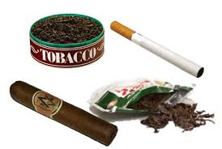
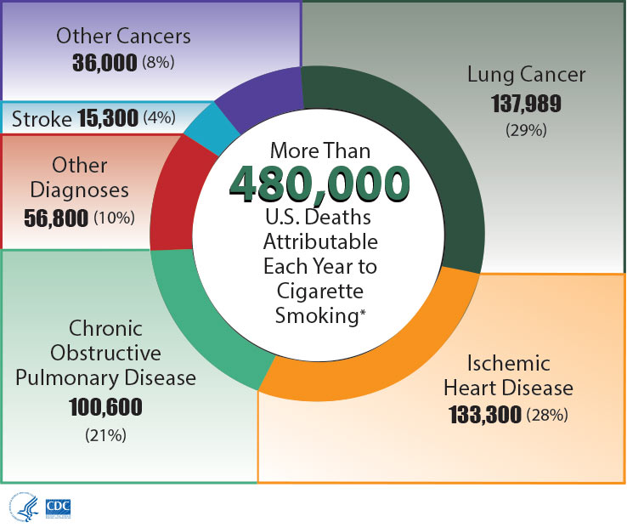
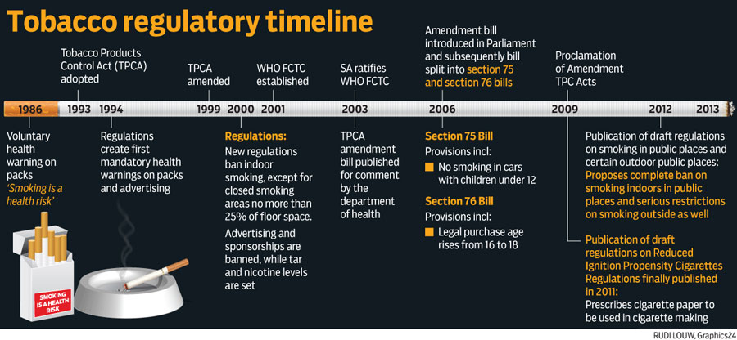
Austin’s Slide

Slide 5
Austin’s Slide
I would wear a nice button up shirt tucked in my blue jeans and my boots.Transportation I would wait tell I had my driver’s license and the take a girl out on a date.And I would go somewhere where it is cheap but not a bad place for money.Take the girl like to putt putt golf and the A restaurant like the Olive Garden.The time I would pick her up is 6:30pm and bring her home at 8:30pm and tell her parents thank you for letting me take her on a date and tell them to have a goodnight and give the girl I took on a date a hug and tell her goodnight and see her later.And what time of the year Spring where it is not too hot or too cold outside.

Slide 6
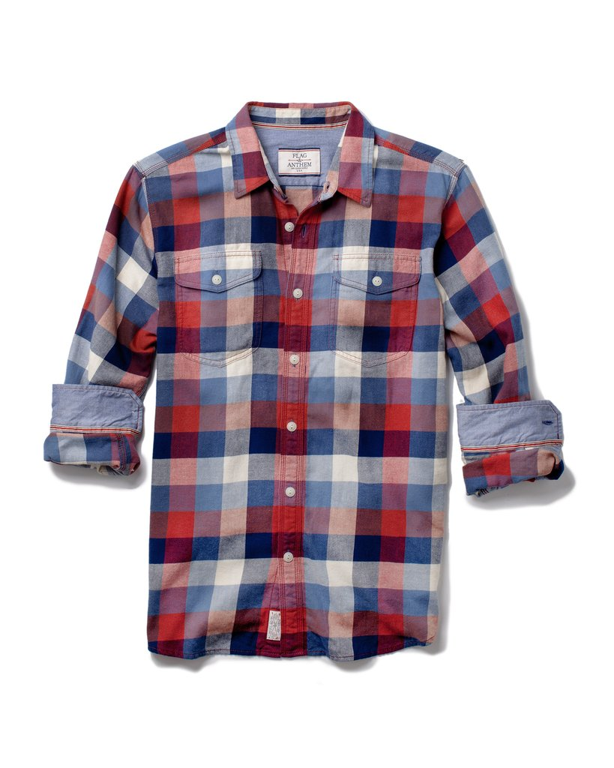
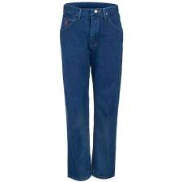
Austin’s slide
I would wear this kind of shirt,These kind of blue jeans,This kind of belt,And a my Cowboy hat.Because I think it is really nice and it looks good.

Slide 7
Brayden Mendoza
How would I dress for a first date? I would probably dress casually, a nice collared shirt and a nice pair of shorts.
My transportation would be 2001 mitsubishi eclipse.
The time i would pick up my date will be 5:30 pm and bring her back at
7:30pm.
The restaurant I will be taking my date would be Cheesecake Factory
The activities for my date would be a movie an

Slide 8
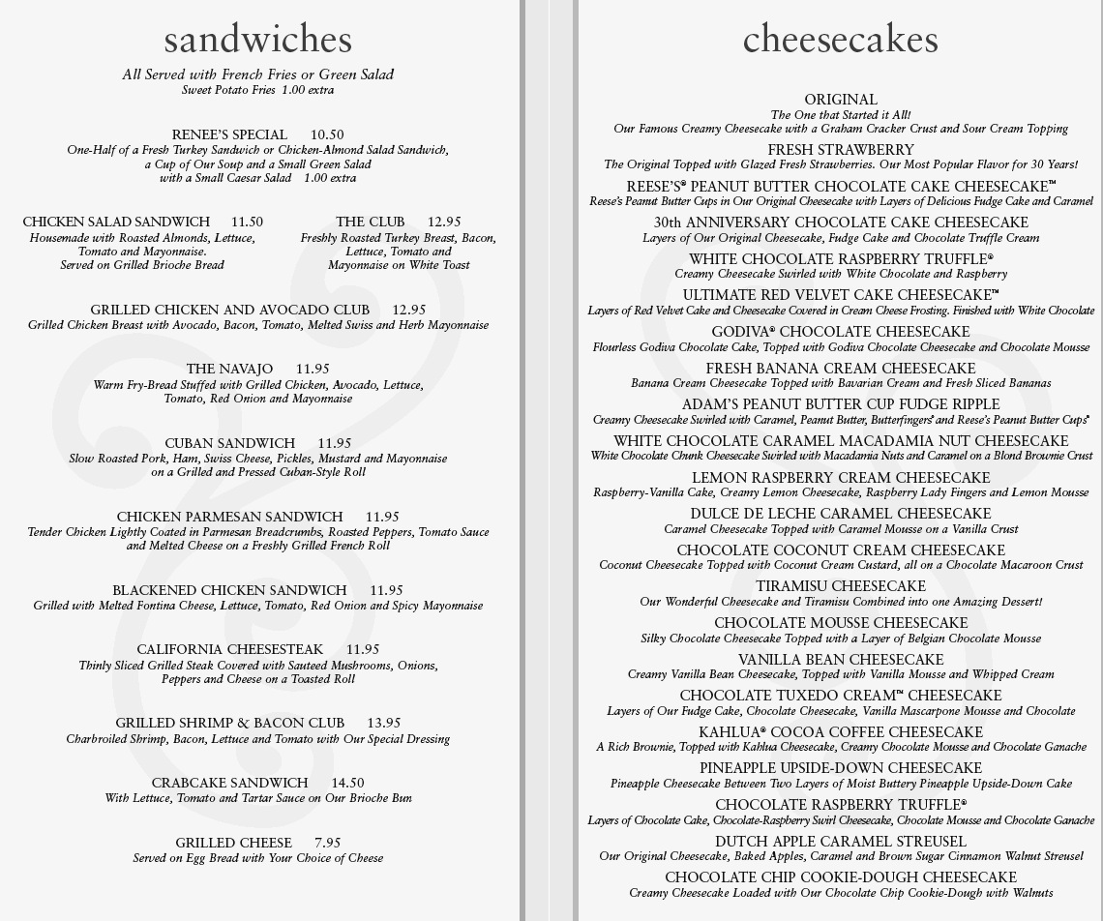
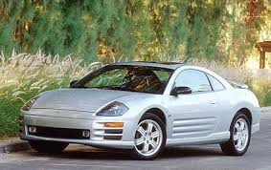
Brayden Mendoza

Slide 9
1492 Columbus discovers tobacco leaves

Slide 10
Corbin’s
Bubba's 33

Slide 11
Corbin’s

Slide 12
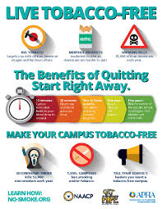
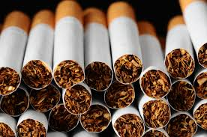
Corbin’s Timeline
1492-10-12: Columbus Discovers Tobacco; "Certain Dried Leaves" Are Received as Gifts, and Thrown Away.
497: Robert Pane, who accompanied Christopher Columbus on his second voyage in 1493, writes the first report of native tobacco use to appear in Europe.
1498- Columbus visits Trinidad and Tobago, naming the latter after the native tobacco pipe.
History of tobacco

Slide 13
Dylan Carrell… first date...
Ideal First Date: If I had to choose where my first date was I would choose Papacitas.
Dress:

Slide 14
Dylan’s

Slide 15
History of Tobacco - Dylan Carrell
1492- Columbus discovered tobacco leaves
1830- the cigarette was born
1950’s- Health hazards began to appear
1700’s- cigars became one of most popular method of smoking
1908- Children’s Act banned selling tobacco under 16

Slide 16
Taylor’s Slide Ideal first date
Ideal first date- A nice dinner (like shoguns) and a walk around a park or something.
How will you dress- some nice jeans with a cute warm top and a scarf with my hair straightened or curled
Transportation- In his car Activities- eat and get to know each other
Cost- $50-60 Time To leave- 6:30
Time to get home- 8:00-8:30 Time Of Year- Winter or Fall

Slide 17
Taylor’s Slide

Slide 18
History Of Tobacco- Taylor King
1604 King james pronounced that smoking was “loathsome to the eyes, hateful to nose, harmful to the brain and dangerous to the lungs.
Scientists come the conclusion that tobacco is harmful companies start putting warnings on packaging 1950
Used by Native Americans of north and south America since 3000 BC
Act made to wear store were not able to sell tobacco to people under 16
1908
History Timeline of Tobacco
Christopher (1492) Columbus 2 crews noticed natives of cuba burning a weed to ward off disease and fatigue
1830 the cigarette is invented
1999 stoped ALL advertisements
Today the age to buy cigarettes is 18 or older and tobacco is the leading cause of preventable illnesses and death in the U.S. It causes many different cancers as well as chronic lung disease such as emphysema, bronchitis, heart disease, ect

Slide 19
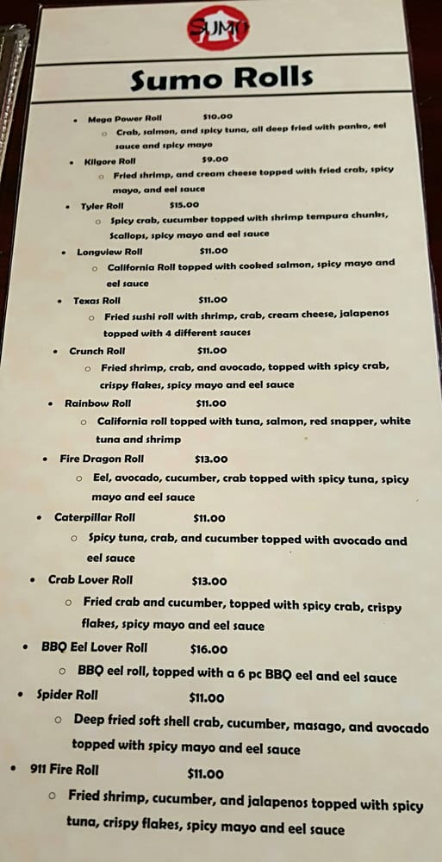
Kadee's slide
My first date would ideally be in October, at an Asian restaurant, because it is not too hot for some onion soup and not cold enough to have sushi.
He would pick me up in his truck around 5:00 and take me home around 8:00, after we get done eating.
I would dress nice, of course. I’d wear dark ripped jeans, an olive shirt, tan ankle boots, and gold or olive accessories.

Slide 20
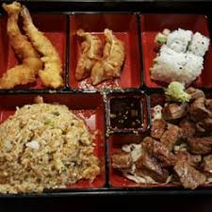
Kadee's slide
Activities
Listen to music
Talk (school,family,baseball,twirling,etc)
Cost
Meal
2 Sushi roll(s)- $20.00
Chicken Rice bowl- $9.00
Steak box- $12.00
Drinks (2)- $4.00
Tip- Depends on waiter/waitress
Total
$45 plus the tip
$50 to $55 (tip)

Slide 21
Back in the day smoke
Mayan civilisation smoked and chewed tobacco. Smoking a pipe was apart of religious ritual.
5000 BC
UK gets smoked
Tobacco is now regularly imported to the UK. In 1604 James 1 required the first tax on tobacco
1600
Children's Act
His act made stores unable to sale tobacco to kids under 16
1908
Big Health Hazard
Finally scientist realised tobacco was harmful. Health warnings began to appear now.
1950
What’s next?
04-Ireland banned smoking in public places
06- Scotland followed
07-England followed
2011- Trends show there will be no smokers in the UK in 30-50 years.
Now- a pack cost cigarettes almost $8.00.
2000-Now
Timeline of Tobacco Kadee Y.
1492
Europe
Christopher arrives and finds out about tobacco leaves. Other explorers (after) embraced the habit of smoking.
1830
The birth of a cigarette
A popular method of smoking was a cigar. This later evolved into the cigarette by 1830.
1914
The Big Seller
Cigarettes hooked the majority of the generation of men. Cigarettes were often glamorized to be something they aren’t.
1970-1990
Who’s smoking now?
70s- Banned smoking on public transportation and in cinemas.
84- National No Smoking Day
87- Smoking/tobacco ads. Were banned on the London Underground
1999- Tobacco ads. Banned completely

Slide 22
Makenna’s slide
An ideal first date would be to go to a nice restaurant for dinner and maybe roller skating or something to get to know each other. I would wear something nice like some jeans and and a nice shirt or sweater since it’s around winter or fall and I would either straighten or curl my hair. He could pick me up in his car or truck around 5:30 and bring me home around 8:00.

Slide 23
Makenna’s slide

Slide 24
The History Of Tobacco - Makenna Caldwelll
European doctors start publishing works on healthy properties of the tobacco plant, claiming it can cure a toothache to lockjaw and cancer.
Native Americans first start cultivating the tobacco plant.
British doctors find that snuff leads to increased risk of nose cancer.
6,000 BC
1571
1791
Christopher Columbus first encounters dried tobacco leaves. They were given to him as a gift by the American Indians.
Tobacco arrives in Africa. European settlers grow it and use it as a currency.
Surgeon General definitively links smoking to lung cancer and presents evidence that it is causing heart problems.
1650
1492
1967

Slide 25
Ty
Ideal first date:
Dinner at Fuji’s
Transportation: His vehicle
Time of year: Fall or Winter
Time to leave: 6:30
Time to be home: 8:45
Dress: nice but not overdressed. Something like jeans and a nice shirt.
Activities: Eat and have good conversation in order to get to know each other better.
Cost: $40-$50

Slide 26
Ty’s slide

Slide 27
Ty
1492: Tobacco is discovered by Christopher Columbus and smoking in introduced in Spain
1908: UK children’s act prevents children under 16 from using tobacco
1610:First tobacco vending machine
History of tobacco
1572: Sir Francis drake introduces pipe smoking to Britain
1912: Tobacco is found to be the cause of lung problems
1730: First tobacco factory

Slide 28
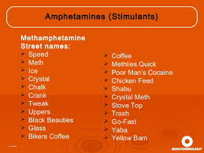
Haley’s
Methamphetamine(Meth) is a stimulant drug usually used as a white, bitter tasting powder or pill. Crystal meth is a form of this drug that looks like glass fragments or shiny, bluish-white rocks. This is similar to amphetamine which is used to treat attention-deficit hyperactivity disorder (ADHD) and Narcolepsy (sleeping disorder). Some women may be using this drug while pregnant this is not something that should happen because children who are exposed to meth before birth can have behavioral problems as young as the age of 3. These problems are manageable yes, but why risk hurting your child? The trick about the exposure of the child to drugs before birth being manageable is that it must be the child and the parent of the child getting help early on rather than waiting till it’s too late. A newer study found around the 90s that researchers have followed children in the Midwest and West who had been exposed to meth while in the mother's womb. They then compared their behavior to that of similar children who hadn’t been exposed to these drugs and found that meth-exposed children found to be more likely to be emotionally reactive, anxious, and depressed at age 3. Also they were found to be more likely to show aggressive behavior and symptoms of ADHD at age 5. Now, we know that the women in the relationship being on drugs during pregnancy has effect on the child’s health, but can the male being on drugs while planning on having kids affect the health of the child? Addiction in the male can hurt the baby but not by birth defects but by early miscarriages.

Slide 29
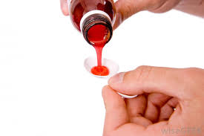
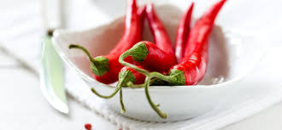
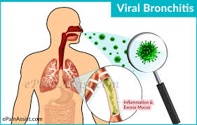
Haley’s slide
Bronchitis- Is the inflammation of the mucous membrane in the Bronchial tubes. This is a very common illness. More than 3 million cases per year in the U.S. It does spread easily it’s usually self treatable, also it only last a few days to a couple of weeks, you can often self diagnose yourself to know you have this illness due to the symptoms you may be having. For example a few of the symptoms may be coughing, runny nose, whole body ache, chest tightness, headache, shortness of breath, sleeping difficult, and or sore throat. Coughing can be critical, dry, or even phlegm. Bronchitis is divided into acute and chronic,acute is also known as a chest cold. 90% of cases are bacterial infections.
Acute bronchitis Also may be caused by bacterial infection and. Exposure to substances that irritate the lungs such as tobacco, smoke, dust, fumes from perfumes or , vapors and air pollution. There is also a chronic bronchitis which is long term and very serious, may be caused the same things as acute. Here are some treatments for bronchitis. Nonsteroidal anti-Inflammatory drug, Analgesic, Narcotic, and Cough medicine. Also home remedies, drink lots water. If you relish spicy food, the antidote to your phlegmy cough and congestion may hiding in your fridge or pantry. Powerful condiments like hot mustard, horseradish, and wasabi can help loosen up bronchial secretions.

